Slide 1
Coordinating Multiple Tasks
Brandon Minnick
Code Traveler, LLC
Notes:
Day 1 taught you what a Task is and what await does to your method. The last section separated waiting from working. This section is about the moment when you have more than one Task in flight and you need a strategy for waiting on all of them. There are only three primitives to learn, and between them they cover almost everything you will meet in real code. Task.WhenAll waits for all of them. Task.WhenAny waits for the first one. Task.WhenEach hands you each one as it finishes. None of the three start any work, and none of them create threads. They only decide how you wait for work that is already running. Hold on to that, because the most common mistake in this material is believing that await is what makes a call happen. https://learn.microsoft.com/dotnet/standard/parallel-programming/task-based-asynchronous-programming

Slide 2
Start Early, Await Late
A Task is already running before you await it
Notes:
This is the single idea the whole section rests on. Calling an async method starts the work. The method runs synchronously until it reaches its first real await, and then it hands you back a Task that is already in progress. The await keyword does not start anything. It only says that you have nothing useful to do until that Task finishes. So when you write var a = await FirstAsync(); var b = await SecondAsync(); you have not asked for two things at once. You have asked for one thing, waited for it, and only then asked for the second. Split the call from the await and both are in flight. Everything else in this section, all three primitives, is bookkeeping layered on top of that one move. Start early, await late. https://learn.microsoft.com/dotnet/csharp/asynchronous-programming/async-scenarios

Slide 3
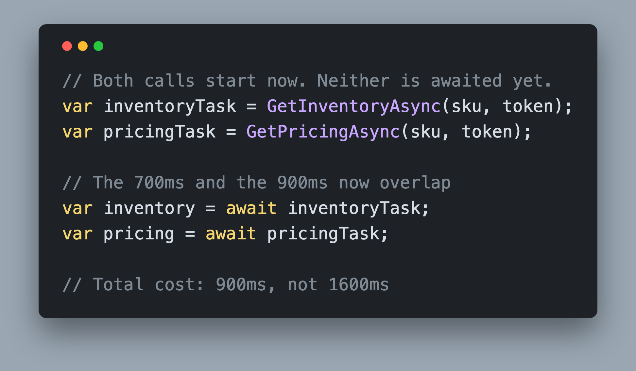
Starting Is Not Awaiting Split the call from the `await`
Calling the method starts the work
`await` only pauses the execution of the method
Notes:
Read the two halves separately. The first two lines call the services and keep the Tasks in variables. Both delays are running the moment those lines execute, so the 700 milliseconds and the 900 milliseconds overlap. The next two lines await them. Awaiting inventoryTask blocks nothing and starts nothing; it just parks the method until that Task is done. By the time you reach the pricing await, the pricing call has had a 700 millisecond head start, so it finishes almost immediately. Total cost is 900 milliseconds, the slowest of the two, not 1600. This pattern works fine for two Tasks. It gets ugly at five, and it gets much worse when the number is not known until run time. That is exactly the gap the WhenAll, WhenAny, and WhenEach family fills. https://learn.microsoft.com/dotnet/csharp/asynchronous-programming/

Slide 4
Task.WhenAll
Notes:
Task.WhenAll is the one you will reach for most. It takes a set of Tasks that are already running and gives you back a single Task that completes when the last one completes. It does not start anything, it does not create threads, and it does not run your Tasks in any particular order. It is a join point and nothing more. If you have ever written a foreach loop that awaits inside the loop, this is the API that turns many waits into one. Inside the runtime it is a WhenAllPromise that keeps a countdown of outstanding Tasks and completes when that count reaches zero. There is nothing magic about it, just careful bookkeeping you no longer have to write yourself. https://github.com/dotnet/runtime/blob/main/src/libraries/System.Private.CoreLib/src/System/Threading/Tasks/Task.cs

Slide 5
Task.WhenAll() System.Threading.Tasks
Await Multiple Tasks Running in Parallel
Runs until all Tasks are Completed
Can be used with `List<Task>`
Returns `Task<T[]>` when every Task returns `T`
Notes:
The first three bullets are the shortest true description of the API. WhenAll awaits multiple Tasks that are already running in parallel, it runs until all of them are complete, and it happily takes a List of Task, an array, or anything else enumerable. The fourth bullet is the payoff. Five calls of 700, 900, 1200, 600 and 800 milliseconds cost 1.2 seconds under WhenAll, because the clock runs once for all of them instead of once each. The generic overload is worth knowing: when every Task returns the same type, WhenAll gives you back a Task of an array, ordered the way you passed the Tasks in, not the order they finished. The last bullet is the one honest downside. WhenAll completes exactly once, so your user sees nothing at all until the slowest service has answered. https://learn.microsoft.com/dotnet/api/system.threading.tasks.task.whenall

Slide 6
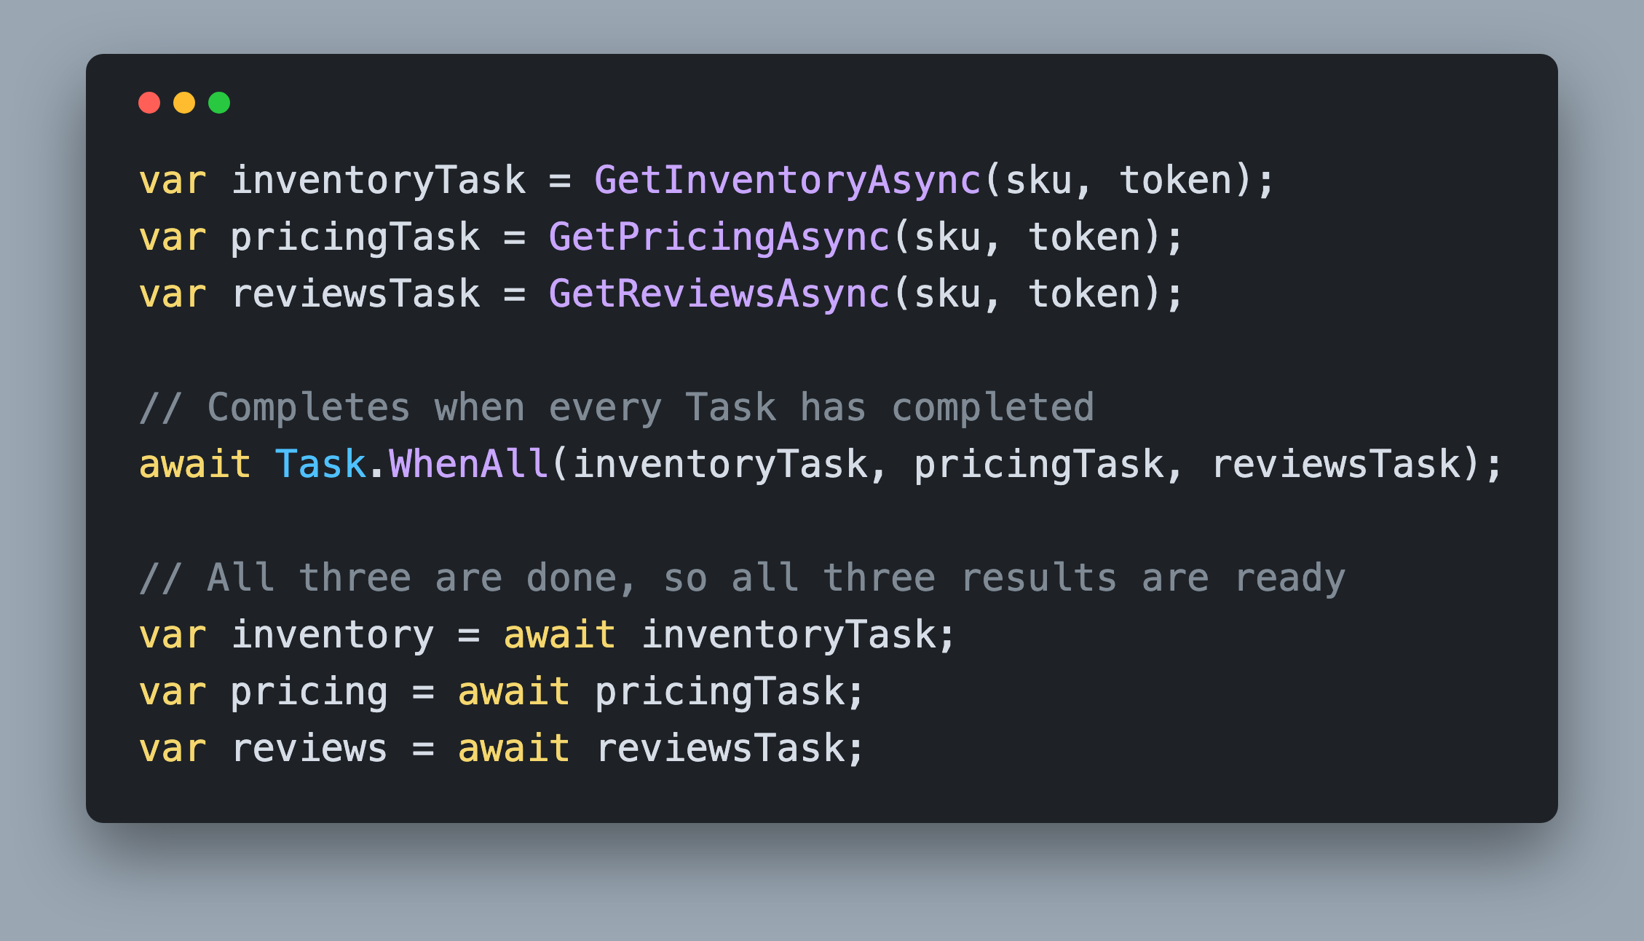
Task.WhenAll() One await, three results
One `await` covers all three calls
Awaiting a completed Task is nearly free
Notes:
Three calls, three variables, then one await. The three service calls run on the lines that create them, which is why the delays overlap. Task.WhenAll returns a Task that completes when the last of the three completes, so that await costs the slowest one. After it, all three Tasks are finished, so awaiting them individually is nearly free and gives you correctly typed results with no casting. That last part surprises people. Awaiting an already completed Task does not go back around the scheduler; it hands you the value almost immediately. If all three returned the same type you could skip those lines and take the array straight from WhenAll. Here they return different types, so this call binds the overload that takes params Task and returns a plain Task, and pulling the results out one at a time is both simpler and better typed. https://learn.microsoft.com/dotnet/api/system.threading.tasks.task.whenall

Slide 7
Task.WhenAll() Failures AggregateException
`await`s every Task
Even if one has Faulted
`await` rethrows only the first exception
Notes:
This is where WhenAll gets misunderstood. It never abandons work. If the second Task faults after 200 milliseconds, WhenAll still waits for the other four, and only then does its own Task fault. That is usually what you want, but it means a failure buys you no time back. The second surprise is the exception. Awaiting a faulted WhenAll rethrows a single exception, and it is the first one in the order you passed the Tasks in, not the first one to fail. If the second Task in your list faults at 200 milliseconds and the first faults at 900, await still throws the first list entry's exception. The others are not lost, they are simply not thrown. Keep the Task in a variable, catch, and read its Exception property to get the AggregateException, then walk InnerExceptions for the full set. And notice the last bullet: even with WhenAll, one try block around the whole thing is still one shared failure. If each caller has to fail on its own, the try has to move next to each call. https://learn.microsoft.com/dotnet/standard/parallel-programming/exception-handling-task-parallel-library

Slide 8
Task.WhenAny
Notes:
Task.WhenAny answers a different question. Not tell me when everything is done, but tell me when the first one is done. It returns a Task of Task, and awaiting it gives you back the actual Task that finished so you can look at it. It completes as soon as any Task completes, whether that Task succeeded, faulted, or was cancelled, and it does not fault itself when the winner faulted. That is a deliberate design choice. WhenAny reports the result of a race, it does not hand you a value. Classic uses are a timeout race between real work and a Task.Delay, a fastest mirror wins download, and driving a progress loop. Used inside a loop, it is also how everyone streamed completions before .NET 9, which is where we go next. https://learn.microsoft.com/dotnet/api/system.threading.tasks.task.whenany

Slide 9
Task.WhenAny() System.Threading.Tasks
Await Multiple Tasks Running in Parallel
Runs until one Task has Completed
Returns the first Task to complete
Can be used with `List<Task>`
Notes:
Same first three bullets as WhenAll, with one word changed: it runs until one Task has completed. Everything else follows from that word. WhenAny gives you the Task that won, not the value, so you await that Task a second time to get its result, and because it is already complete that second await is nearly free. WhenAny completing does not mean success. If the winner faulted, WhenAny still completes successfully and hands you the faulted Task, and the throw happens on your second await. Treat that as a feature: it lets you inspect a loser as easily as a winner. The uses on the last bullet are the ones you will actually write. A timeout is just your work Task racing a Task.Delay, and whichever comes back first tells you what happened. https://learn.microsoft.com/dotnet/api/system.threading.tasks.task.whenany

Slide 10
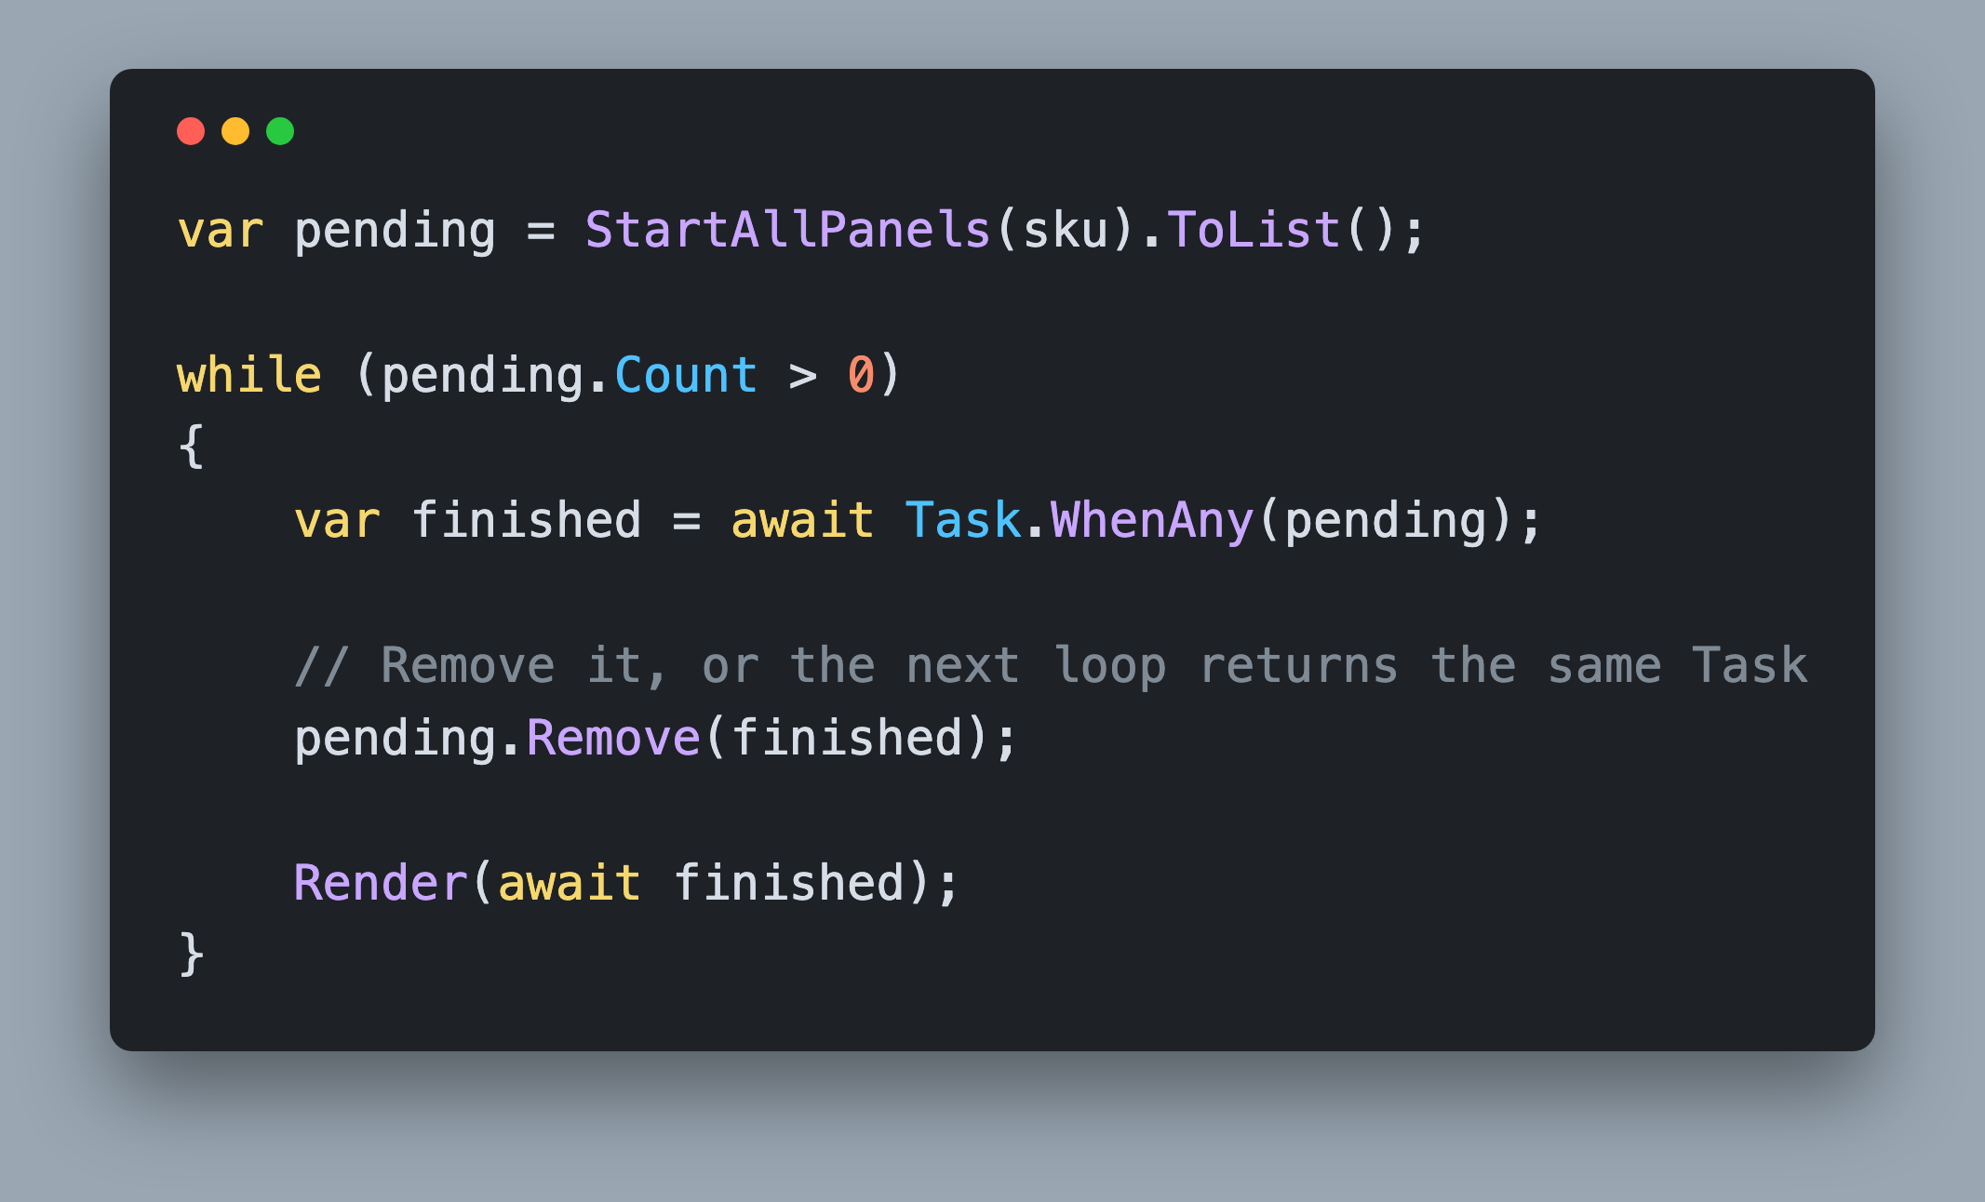
Task.WhenAny() Remove The Completed Task
Forget to call `Remove` and you loop forever
Notes:
This is the loop everyone writes the first time they want results as they arrive, and it has one trap in it. WhenAny gives you the Task that finished, and a finished Task stays finished forever. If you do not take it out of the list, the next call to WhenAny sees a completed Task sitting there and returns it again immediately, and again, and again. That is an infinite loop that pegs a core and re-renders the same result forever, because the pending count never drops and WhenAny keeps handing back the one Task that already finished. The Remove call is the whole fix. Note also that this pattern is quadratic. Every call to WhenAny registers a continuation on every remaining Task, so with a hundred Tasks you register several thousand continuations over the life of the loop. It is fine for five panels. It is a real cost at scale, which is one of the reasons the next API exists. https://learn.microsoft.com/dotnet/api/system.threading.tasks.task.whenany

Slide 11
Task.WhenEach
Notes:
Task.WhenEach is new in .NET 9 and it does exactly what the WhenAny loop did, with none of the bookkeeping. It returns an IAsyncEnumerable of Task, so you consume it with await foreach, and the runtime hands you each Task the moment that Task completes. No pending list, no Remove, no chance of an infinite loop, and no quadratic continuation registration. Note the shape carefully, because it yields Tasks and not results. That is deliberate. A Task carries its own outcome, so a faulted Task can be handed to you exactly like a successful one, and you decide what happens when you await it. If your team is still on .NET 8 or earlier, the WhenAny loop from the previous slide is the supported way to do this. https://learn.microsoft.com/dotnet/api/system.threading.tasks.task.wheneach

Slide 12
Task.WhenEach() IAsyncEnumerable<Task>
`await foreach`
Streams results from multiple Tasks running in parallel
Notes:
Read the first three bullets as one sentence. WhenEach streams results from multiple Tasks running in parallel, you consume it with await foreach, and the loop body runs once per completed Task, at the moment it completes. Tasks are handed to you as they complete, so in practice you see them roughly in finishing order rather than the order you passed them in. The docs deliberately do not guarantee an exact order for Tasks that complete at nearly the same time, so do not depend on the sequence. Depend on the fact that you get each one as soon as it is done. The .NET 9 line matters for your day job. If your team is on .NET 8, this method is not there and you fall back to the WhenAny loop. The last two bullets are where people trip. WhenEach yields a Task, so you await it inside the loop to get the value. And a faulted Task is yielded exactly like a successful one, so if you did not handle the failure closer to the call, that inner await is where it throws, and it will end your foreach loop. https://learn.microsoft.com/dotnet/api/system.threading.tasks.task.wheneach

Slide 13
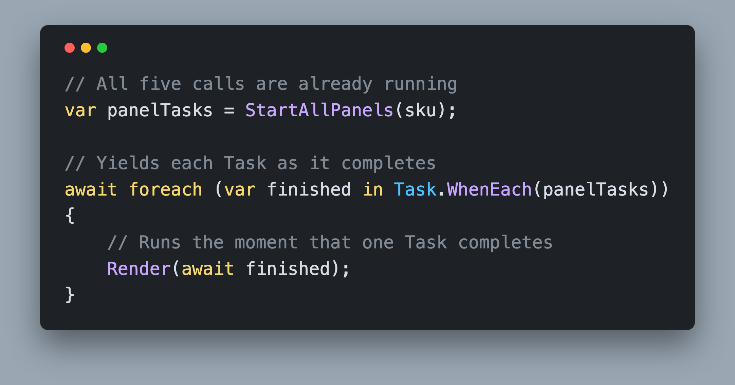
Task.WhenEach() await foreach
Same total time as `Task.WhenAll`
The difference is when the user sees each result
Notes:
Nine lines, and three of them are comments. Build the list of Tasks first, which starts all of them. Hand the list to Task.WhenEach and await foreach over the result. Each time a Task finishes, the loop body runs with that Task in hand, and awaiting it gives you the value. Compare this against the WhenAny loop two slides back: no pending list, no Remove, and nothing you can forget that turns into an infinite loop. The total time is identical to WhenAll, because both finish when the slowest Task finishes. The only difference is what the user sees along the way. WhenAll shows a spinner and then everything at once. WhenEach fills the screen in as the answers land, which feels dramatically faster even though the clock reads the same number. https://learn.microsoft.com/dotnet/csharp/asynchronous-programming/generate-consume-asynchronous-stream

Slide 14
Choosing Between Them All, Any, Each
`Task.WhenAll`
You need everything before you continue
`Task.WhenAny`
One winner is enough
`Task.WhenEach`
Show each result the moment it lands
Notes:
Here is the decision in one slide. Reach for WhenAll when the next line of code needs every result, which is most of the time. Reach for WhenAny when one answer ends the question, most often a timeout race between your work and a Task.Delay. Reach for WhenEach when the results are independently useful and a person is watching, like five panels on a product page. WhenAll and WhenEach cost the same wall clock time, because both wait on the same set of already running Tasks. Choosing between those two is a user experience and error handling decision, not a performance one. WhenAny is different. A single WhenAny returns the moment the first Task completes, which is why it is the timeout primitive. Only WhenAny used inside a drain loop costs the same as the other two. And all three require you to start the Tasks first. Passing in a list you built by awaiting each call in turn buys you nothing at all. https://learn.microsoft.com/dotnet/standard/parallel-programming/task-based-asynchronous-programming

Slide 15
Challenge: Coordinate the Product Page ProductDetails, 20 minutes
Open `6. Coordinating Multiple Tasks/1. Start`
Run it, click Load product page, read the timings
Start all five calls before awaiting any of them
Paint each panel as its own service answers
Keep the broken service inside its own panel
Target: 1.2 seconds, five cards, one of them red
Compare with `2. Finish`
Notes:
Twenty minutes. Open the Start project, run it, and click the button before you change anything, because the timings on the cards are the evidence. You should see 0.7, 1.6, 2.8 and 3.4 seconds, one card reading never requested, and 4.2 seconds on the tile. Then go fix it. Start all five calls before you await any of them, give each call somewhere to fail that is not the whole page, and repaint as each service answers. Any of the three primitives will get the clock down to 1.2 seconds. Which one you pick decides whether the cards appear together or one at a time. When you are done you should have five cards, four of them green with timings between 0.6 and 1.2 seconds, one red carrying a short failure message, with the 503 itself in your terminal, and no banner across the top. Then we will review approaches together before the walkthrough.

